Slide 1
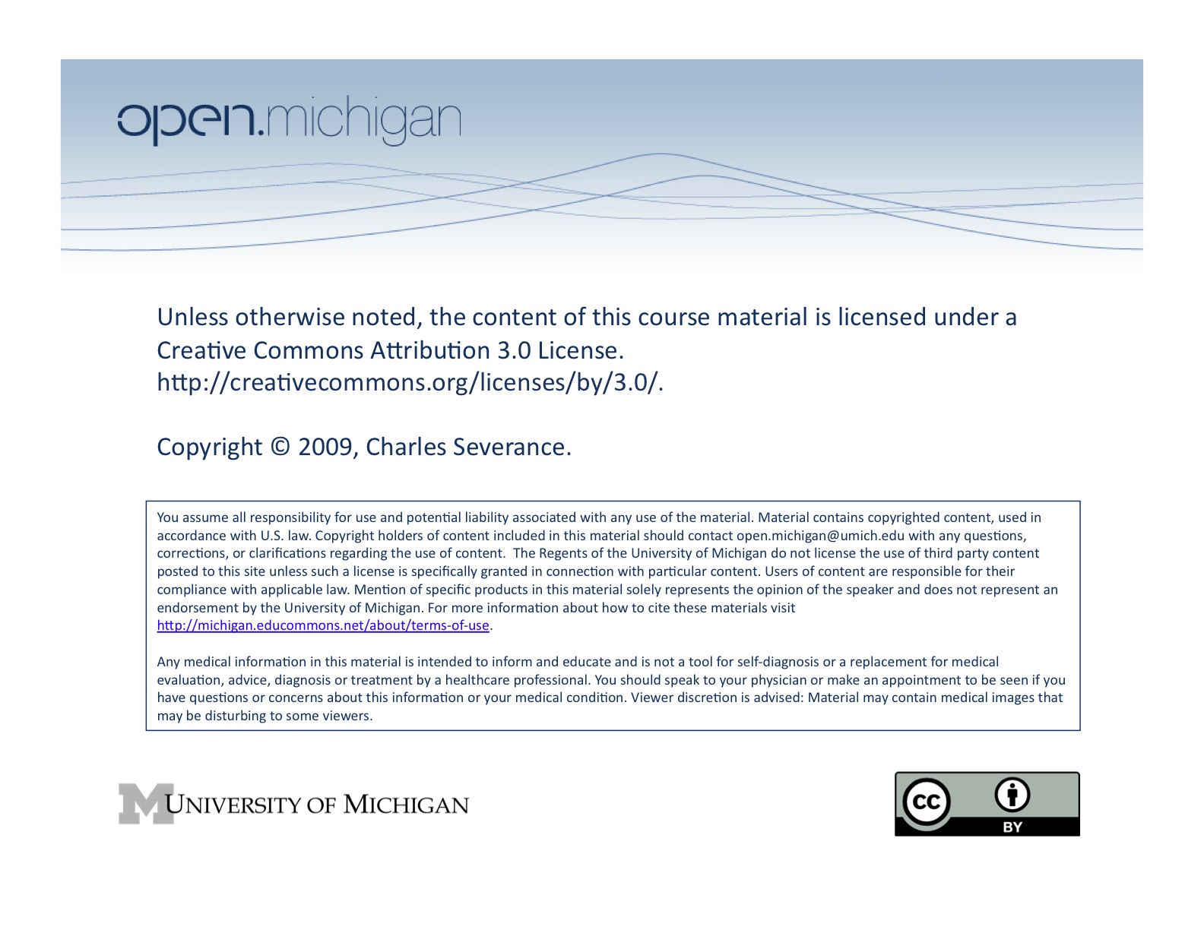

Slide 2
CSS
Cascading Style Sheets
Charles Severance
www.dr-chuck.com
http://en.wikipedia.org/wiki/Cascading_Style_Sheets

Slide 3
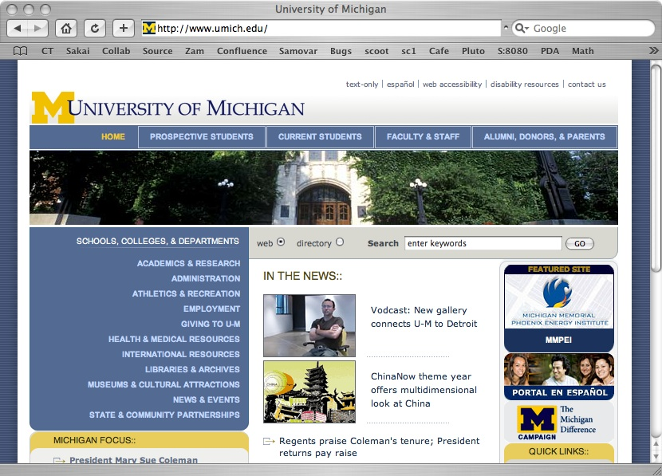
The big picture...
<!DOCTYPE html PUBLIC "-//W3C//DTD XHTML 1.0 Strict//EN" "http://www.w3.org/TR/xhtml1/DTD/xhtml1-strict.dtd">
<html xmlns="http://www.w3.org/1999/xhtml" xml:lang="en">
<head>
<title>University of Michigan</title>
....
@import "/CSS/graphical.css"/**/;
p.text strong, .verbose, .verbose p, .verbose h2{text-indent:-876em;position:absolute}
p.text strong a{text-decoration:none}
p.text em{font-weight:bold;font-style:normal}
div.alert{background:#eee;border:1px solid red;padding:.5em;margin:0 25%}
a img{border:none}
.hot br, .quick br, dl.feature2 img{display:none}
div#main label, legend{font-weight:bold}
In the modern era of web design we represent content and meaning in HTML and formatting and layout in CSS.
Source: http://www.umich.edu

Slide 4
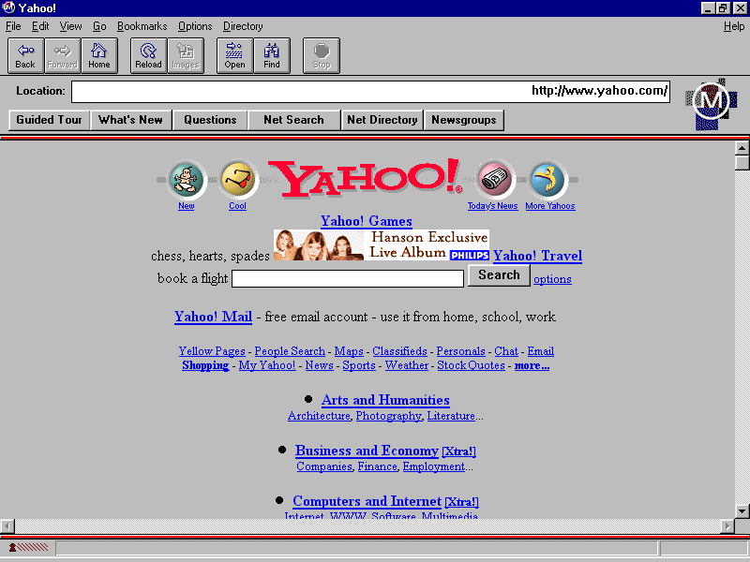
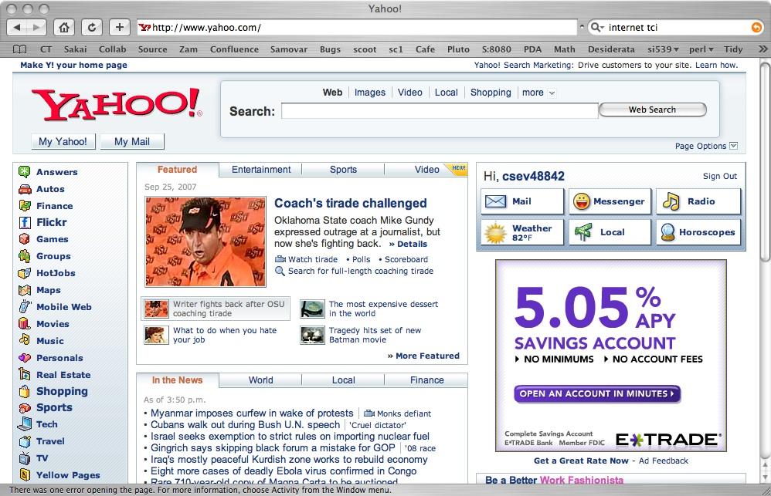
HTML has evolved a *lot* over the years - as computers and networks have gotten faster.
1995
2007
Source: www.yahoo.com

Slide 5
CSS Allows Separation of effort / specialization
Developer
Designer
<!DOCTYPE html PUBLIC "-//W3C//DTD XHTML 1.0 Strict//EN" "http://www.w3.org/TR/xhtml1/DTD/xhtml1-strict.dtd">
<html xmlns="http://www.w3.org/1999/xhtml" xml:lang="en">
<head>
<title>University of Michigan</title>
....
@import "/CSS/graphical.css"/**/;
p.text strong, .verbose, .verbose p, .verbose h2{text-indent:-876em;position:absolute}
p.text strong a{text-decoration:none}
p.text em{font-weight:bold;font-style:normal}
div.alert{background:#eee;border:1px solid
...
Everyone needs to know some HTML and some CSS and some programming - but to be truly skilled at a professional level requires deep understanding and specialization.

Slide 6
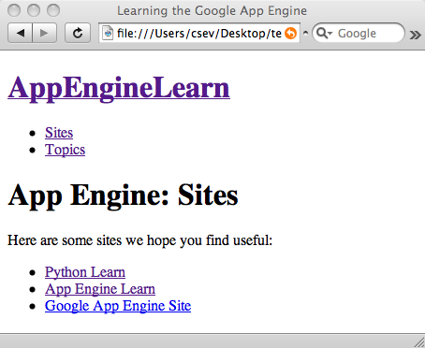
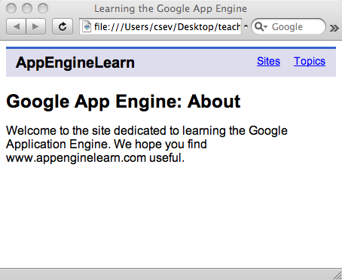

Tranforming the look and feel of a page using a CSS style sheet.
+
body {
font-family: arial, san-serif;
}
a, a:link
{
color: #0000cc;
}
...

Slide 7
Applying Basic Styles

Slide 8
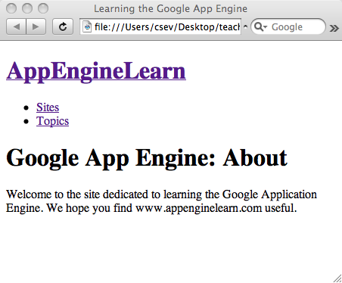
The Browser has “default styling” for all tags.
<h1><a href="index.htm">
AppEngineLearn</a></h1>
<ul>
<li><a href="sites.htm">Sites</a></li>
<li><a href="topics.htm" >Topics</a></li>
</ul>
<h2>Google App Engine: About</h2>
<p>
Welcome to the site dedicated to
learning the Google Application Engine.
We hope you find
www.appenginelearn.com useful.
</p>

Slide 9
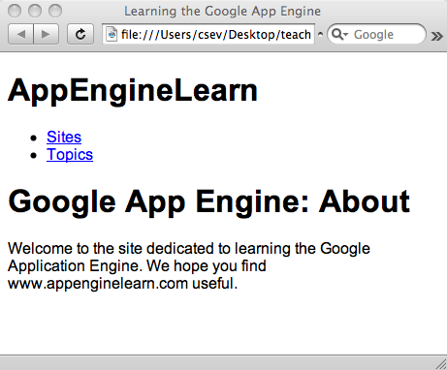
We will apply CSS to the tags in the document.
With no changes to the HTML.

Slide 10
Lots of CSS properties to play with
background-color, border-width, border-color, margin-top, padding, font-family, top, left, right, float, font-size, background-image, text-align, text-decoration, font-style, font-weight, vertical-align, visibility, overflow, ....
We can set these properties on any HTML tag in a document.

Slide 11
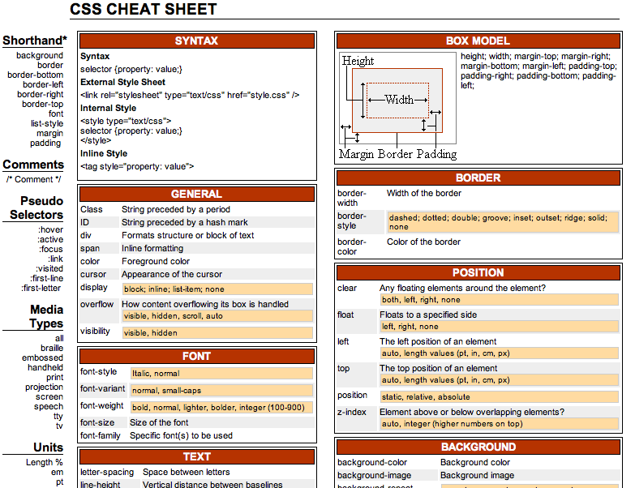
Source: http://www.lesliefranke.com/files/reference/csscheatsheet.html

Slide 12
Anatomy of a CSS Rule
selector - which part of the document does this rule apply to
body
font-family: arial, sans-serif;
font-size: 100%; }
property - which aspect of CSS are we changing
value - What are we setting the property to.

Slide 13
Multiple tags with same styling
h1, h2, h3 {
color: yellow;
background-color: black;
}
Making a noticeable background color is a fun way to debug / identify blocks.

Slide 14
Three ways to add style rules
Inline Style - Add style information to a tag
Embedded Style - Add style information to the document at the beginning
External Style Sheet - Put all of your style in an external file
  Preferred - because two people can work independently

Slide 15
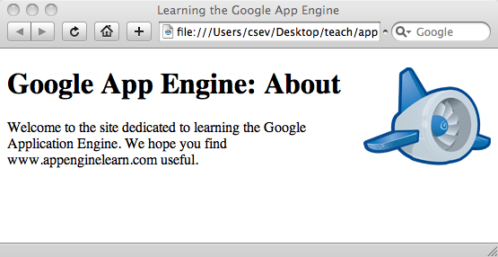
Inline Styles
<h1>
<img src="appengine.jpg" width="142" height="109“
alt="Google App Engine Logo“
style="float:right"/>
Google App Engine: About</h1>
<p>
Welcome to the site dedicated to
learning the Google Application Engine.
We hope you find
www.appenginelearn.com useful.
</p>

Slide 16
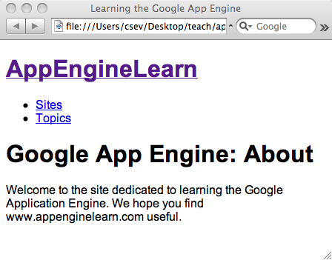
Embedded Style
<html xmlns="http://www.w3.org/1999/xhtml"> <head>
<title>Learning the Google App Engine</title> <style type="text/css">
body {
font-family: arial, sans-serif;
}
</style>
</head>
<body>
<h1><a href="index.htm">
AppEngineLearn</a></h1>
<ul>
<li><a href="sites.htm">Sites</a></li> <li><a href="topics.htm" >Topics</a></li> </ul>

Slide 17
External Style Sheets
<html xmlns="http://www.w3.org/1999/xhtml">
<head>
<title>Learning the Google App Engine</title>
<link type="text/css" rel="stylesheet" href="glike.css"> </head>
<body>
<h1><a href="index.htm">
AppEngineLearn</a></h1>
<ul>
<li><a href="sites.htm">Sites</a></li>
<li><a href="topics.htm" >Topics</a></li>
</ul>
glike.css:
body {
font-family: arial, sans-serif;
}

Slide 18
<head>
<title>Learning the Google App Engine</title>
<link type="text/css" rel="stylesheet" href="glike.css">
</head>
csev$ ls –l
total 32
-rw-r--r-- 1 csev staff 44 Jan 28 13:14 glike.css-rw-r--r-- 1 csev staff 680 Feb 17 08:25 index.htm-rw-r--r-- 1 csev staff 886 Feb 17 08:00 sites.htm-rw-r--r-- 1 csev staff 681 Feb 17 08:01 topics.htm
csev$
We put the CSS file in the same directory so the link works.

Slide 19

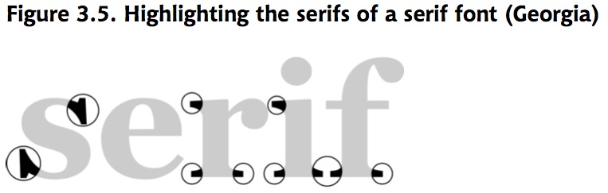
Fonts
Default fonts are ugly and they have Serifs - which make them harder to read on a screen
So the first thing I usually want to do is override the font in my document
And I want to do this everywhere.

Slide 20
Fonts
Most Favourite
Least Favourite
body {
font-family: "Trebuchet MS", Helvetica, Arial, sans-serif;
font-size: x-large;
}
Fallback fonts: serif, sans-serif, monospace, cursive and fantasy.

Slide 21
Font Factors
font-size:
xx-small
x-small
small
medium
large
x-large
xx-large
font-weight: bold or normal
font-style: normal or italic
text-decoration: none, underline, overline, or line-through

Slide 22
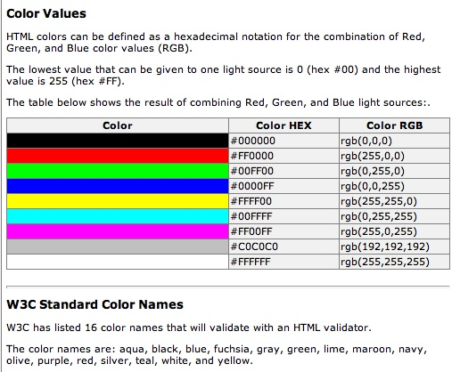
Color Names
W3C has listed 16 color names that will validate with an HTML validator.
The color names are: aqua, black, blue, fuchsia, gray, green, lime, maroon, navy, olive, purple, red, silver, teal, white, and yellow.
Source: http://www.w3schools.com/html/html_colors.asp

Slide 23
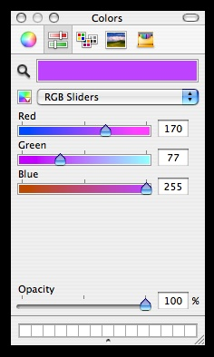
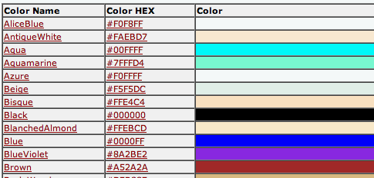
Colors by the number...
#e2edff
Three Numbers, Red, Green , and Blue - each from 00 - FF (Hexidecimal)
#edf
= #eeddff
#ffffff = white
#000000 = black
#ff0000 = red
#00ff00 = green
#0000ff = blue
Web-safe
colors
Source: http://www.w3schools.com/css/css_colornames.asp

Slide 24

Default Styling for Links
Post-Click:
Downright Ugly!
Source: www.yahoo.com

Slide 25
Styling Links
a {
font-weight: bold;
}
a:link {
color: black;
}
a:visited {
color: gray;
}
a:hover {
text-decoration: none;
color: white;
background-color: navy;
}
a:active {
color: aqua;
background-color: navy;
}
link - before a visit
visited - after it has been visited
hover - when your mouse is over it but you have not clicked
active - you have clicked it and you have not yet seen the new page
Browser default styling for links is downright ugly!

Slide 26
CSS Tags and Attributes
As CSS was introduced they introduced two new tags that are pretty much there to serve as handles for styling
  <div> - A block tag (breaks justification)
  <span> - An inline tag that does not break justification
There are two attributes with special meaning to CSS
  id= - Marks a unique block within the document for styling (use only once)
  class= - Marks a non-unique tag within the document for styling (multi-use)

Slide 27
div as Container
<div>
<p>This is a paragraph inside a div.</p>
<p>So is this.</p>
</div>
The id attribute on the tag allows us to uniquely mark a div in a document. The id tag is also useful for screen readers.
<div id="header">
<ul>
<li><a href="sites.htm">Sites</a></li> <li><a href="topics.htm" >Topics</a></li>
</ul>
</div>
“div” stands for “division” as it allows us to divide our page into parts or sections and then do something different with each “section”.

Slide 28
Styling a block with “id”
Everything within block
Paragraphs within block
#footer {
font-style: italic;
font-family: Times, serif;
}
#footer p {
font-style: italic;
font-family: Times, serif;
}
or
<div id="footer">
<p>Please send any comments to csev@umich.edu</p>
</div>
id= identifies a *particular* block - only one in a document

Slide 29
Nested divs
<div id="outer">
<div id="nested1">
<p>A paragraph inside the first nested div.</p>
</div>
<div id="nested2">
<p>A paragraph inside the second nested div.</p>
</div>
</div> <!-- End of the outer div -->
Adding divs give us a “handle” to apply styling (CSS) to a block of text.

Slide 30
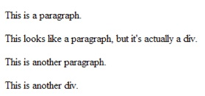
Paragraphs and Divs
<p>This is a paragraph.</p>
<div>This looks like a paragraph, but it's actually a div.</div>
<p>This is another paragraph.</p>
<div>This is another div.</div>
Think

Slide 31
Styling with class=
.fun {
color: #339999;
font-family: Georgia, Times, serif;
letter-spacing: 0.05em;
}
<p class="fun">A man walks into a bar; you would've thought he'd see it coming!</p>
<p>Have a nice day.<p>
<p class=”fun”>More fun stuff</p>
class can be used many times in a document.

Slide 32
Span (Invisible tag)
<p><span class="fun">Bubble Under</span> is a group of diving
enthusiasts based in the south-west UK who meet up for diving
trips in the summer months when the weather is good and the
bacon rolls are flowing. We arrange weekends away as small
groups to cut the costs of accommodation and travel and to
ensure that everyone gets a trustworthy dive buddy.</p>
Sometimes you want to style something smaller than a whole block - then use span. Do not use span if you are applying something to a whole block - just put your styling on the enclosing block tag.

Slide 33
<body>
<div id="header">
<h1><a href="index.htm“class="selected">SI502</a></h1>
<ul class="toolbar">
<li><a href="books.htm">Books</a></li>
<li><a href="topics.htm" >Topics</a></li>
</ul>
</div>
<div id="bodycontent">
<h1>Networked Computing: About</h1>
<p>
This course is a survey course covering a broad
range of technology topics at a high level.
The course is aimed at students with no prior
technical skills other than the general use of
a computer. Really!
</p>
</div>
</body>
When building HTML, we use id and class to add little “handles” in the HTML to make it so we can “style” areas of the document.
Pick div id’s to indicate meaning.

Slide 34
Source: http://www.lesliefranke.com/files/reference/csscheatsheet.html

Slide 35
A Running Example...

Slide 36
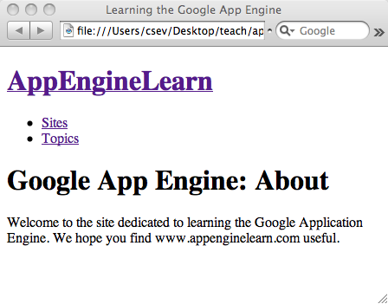
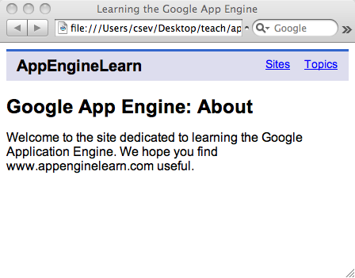
Transform from ugly to fancy with CSS

Slide 37
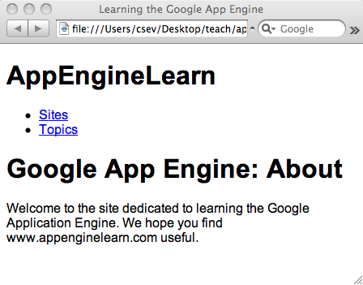
First: Just work with the tags and fix fonts / colors

Slide 38
<head>
<title>Learning the Google App Engine</title>
<link type="text/css" rel="stylesheet" href="glike.css">
</head>
body {
font-family: arial, sans-serif;
}
a {
color: blue;
}
h1 a {
text-decoration: none;
color: black;
}

Slide 39
Block Layout

Slide 40
Quick Advertisement - Firefox
You pretty much need to use Firefox for serious website development
Important plugins:
  Web Developer - Chris Pedrick
  FireBug - Joe Hewitt
http://addons.mozilla.org/

Slide 41
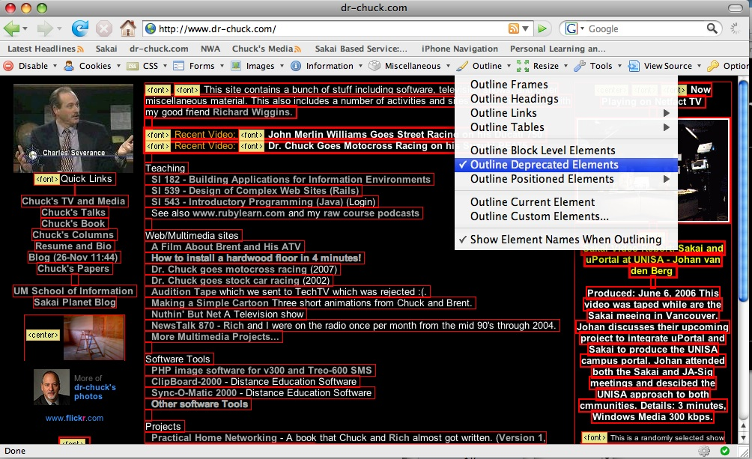
Source: www.dr-chuck.com

Slide 42
Two kinds of elements
Inline - affects how text looks
  strong, span
Block - Containers that can be laid out
  Paragraphs, etc
CSS can change a tag from inline to block
#navigation li {
display: inline;
}

Slide 43
Inline Elements
Flowed with other text
span, em, strong, cite, a
Inline tags can be nested as long as they match
  <span class=”important”><cite>Stuff</cite></span>
Block can contain inline - but inline cannot contain block

Slide 44
Block Level Elements
Starts on its own line - ends justification and starts a new block
Can be a container for other elements
h1 - h6, p, div, blockquote, ul, ol, form
Blocks can contain other blocks
<div id=”content”>
<p>One </p>
<p>Two</p>
</div>

Slide 45
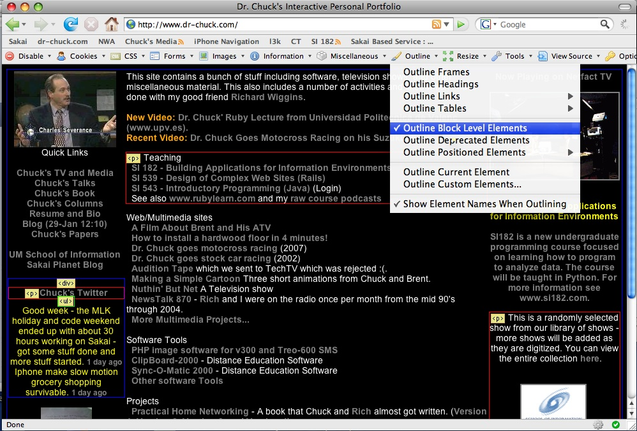
Source: www.dr-chuck.com

Slide 46
Now we will move things around, add background and borders, etc.

Slide 47
<body>
<div id="header">
<h1><a href="index.htm">AppEngineLearn</a></h1>
<ul>
<li><a href="sites.htm">Sites</a></li>
<li><a href="topics.htm" >Topics</a></li>
</ul>
</div>
<div id="content">
<h2>Google App Engine: About</h2>
<p>
Welcome to the site dedicated to
learning the Google Application Engine.
We hope you find www.appenginelearn.com useful.
</p>
</div>
</body>
Mark our major blocks with divs and id atributes.

Slide 48
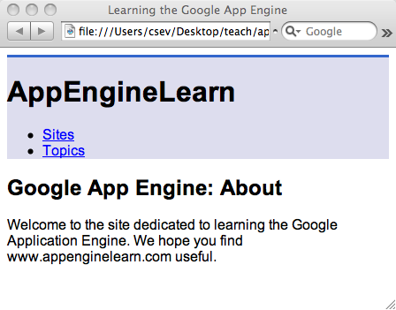
body {
font-family: arial, sans-serif;
}
#header {
background-color: #dde;
border-top: 3px solid #36c;
}
a{
color: blue;
}
#header h1 a {
text-decoration: none;
color: black;
}

Slide 49
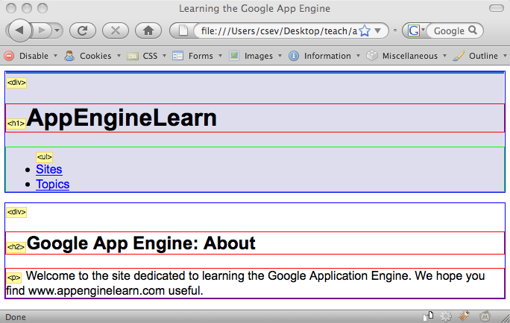
<body>
<div id="header">
<h1><a href="index.htm">AppEngineLearn</a></h1>
<ul>
<li><a href="sites.htm">Sites</a></li>
<li><a href="topics.htm" >Topics</a></li>
</ul>
</div>
<div id="content">
<h2>Google App Engine: About</h2>
<p>
Welcome to the site dedicated to
learning the Google Application Engine.
We hope you find www.appenginelearn.com useful.
</p>
</div>
</body>
Next we will move these blocks around.

Slide 50
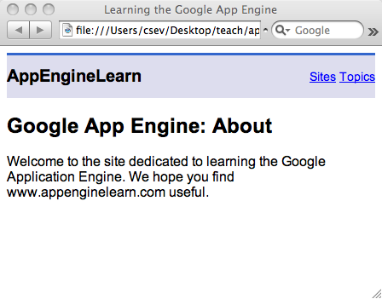
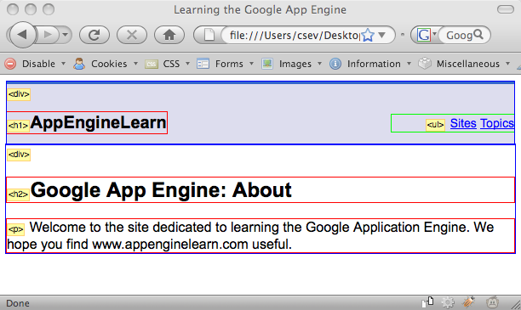
#header {
background-color: #dde;
border-top: 3px solid #36c;
height: 100%;
overflow:hidden;
}
#header h1 {
font-size: 20px;
float: left;
vertical-align: middle;
}
#header li {
font-size: 14px;
display: inline;
}
#header ul {
list-style: none;
float:right;
vertical-align: middle;
}

Slide 51
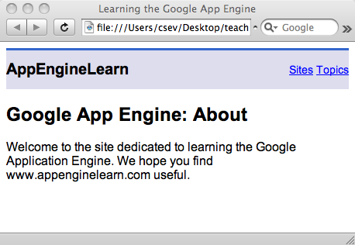
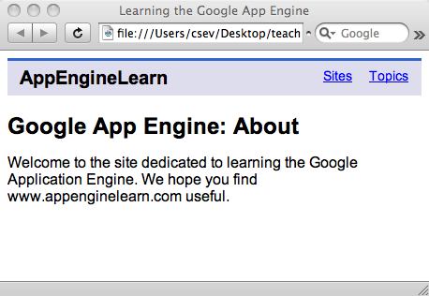
Now lets do some “tweaking”

Slide 52
CSS Box Model
height and width properties size the block element
margin properties define the space around the block element
border properties define the borders around a a block element
padding properties define the space between the element border and the element content
background properties allow you to control the background color of an element, set an image as the background, repeat a background image vertically or horizontally, and position an image on a page
http://reference.sitepoint.com/css/boxmodel

Slide 53
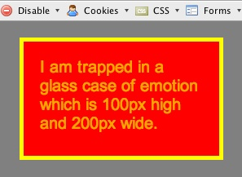
The Box Model
.trapped {
height: 100px;
width: 200px;
margin: 20px;
border: 5px solid yellow;
background:red;
padding: 20px;
font-family:Arial;
color:orange;
font-size:20px;
}
<p class=”trapped”>
I am trapped in a glass case of emotion
which is 100px high and 200px wide.
</p>
20
1
9
0
20
1
5
0
1
4
0
1
0
0
5

Slide 54
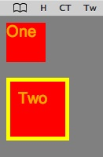
Border, padding, and margin are additive.
.trapped {
height: 50px;
width: 50px;
}
.trapped2 {
height: 50px;
width: 50px;
border: 5px solid yellow;
padding: 10px;
}
<p class="trapped">
One</p>
<p class="trapped2">
Two</p>

Slide 55
#header {
background-color: #dde;
border-top: 3px solid #36c;
height: 100%;
overflow:hidden;
padding: 7px;
margin-top: 5px;
}
#header h1 {
font-size: 20px;
float: left;
vertical-align: middle;
margin: 0;
padding: 0 0 0 .3em;
}
#header li {
font-size: 14px;
display: inline;
padding: .5em;
}
#header ul {
list-style: none;
text-align: right;
float:right;
vertical-align: middle;
margin: 0;
padding: 0;
}
top, right, bottom, left

Slide 56
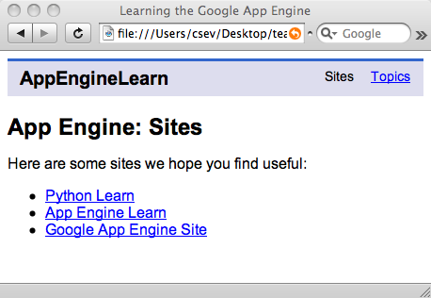
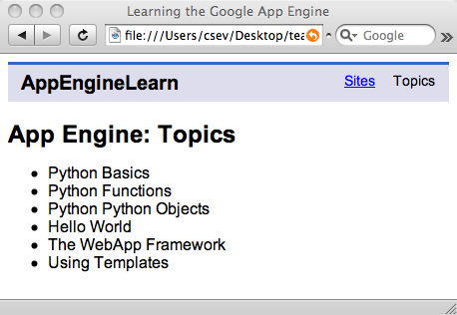
<div id="header">
<h1><a href="index.htm">AppEngineLearn</a></h1>
<ul>
<li><a href="sites.htm" class="selected">Sites</a></li>
<li><a href="topics.htm" >Topics</a></li>
</ul>
</div>
#header li a.selected {
color: black;
text-decoration: none;
}
<div id="header">
<h1><a href="index.htm">AppEngineLearn</a></h1>
<ul>
<li><a href="sites.htm">Sites</a></li>
<li><a href="topics.htm" class="selected">Topics</a></li>
</ul>
</div>

Slide 57
Tranforming the look and feel of a page using a CSS style sheet.
+
body {
font-family: arial, san-serif;
}
a, a:link
{
color: #0000cc;
}
...

Slide 58
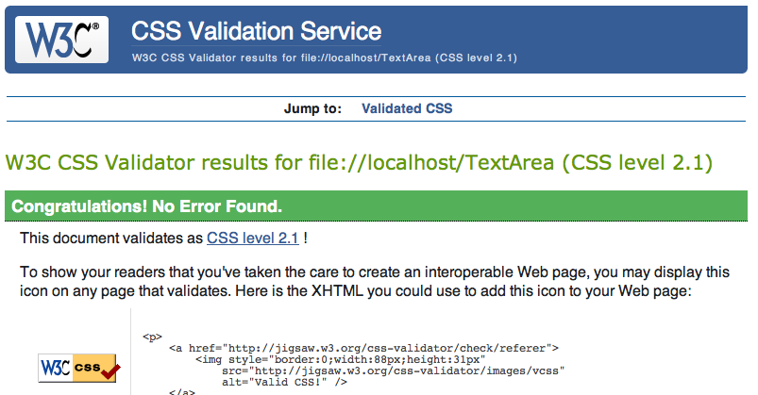
CSS Validation
You can validate your CSS to make sure it has no syntax errors
Browsers will generally quietly ignore bad CSS syntax
http://jigsaw.w3.org/css-validator
The validator can save you time
and sanity
Source: W3C http://validator.w3.org/check

Slide 59
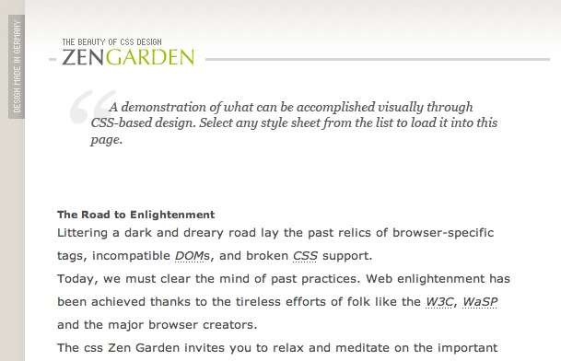
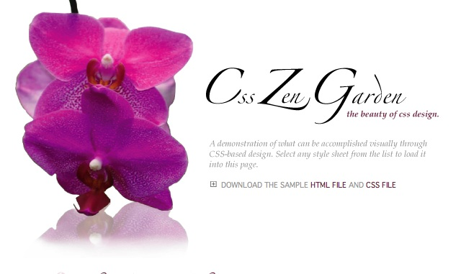
Zen Garden
A social site where CSS designers show their “stuff”
The HTML never changes - only the CSS
Inspiration for us designers
Source: http://www.csszengarden.com/

Slide 60
Summary
CSS Layout is its own art and science
CSS Basics are well established and well supported in all modern browsers
The box model is pretty straightforward - and allows nice design within the standards with reasonable effort levels.
Site layout and markup is further evolving - mostly to make it increasingly possible to support desktop like experiences on the web.
These innovations will naturally cause incompatibilities - which make things interesting and frustrating at times.

